Slide 1
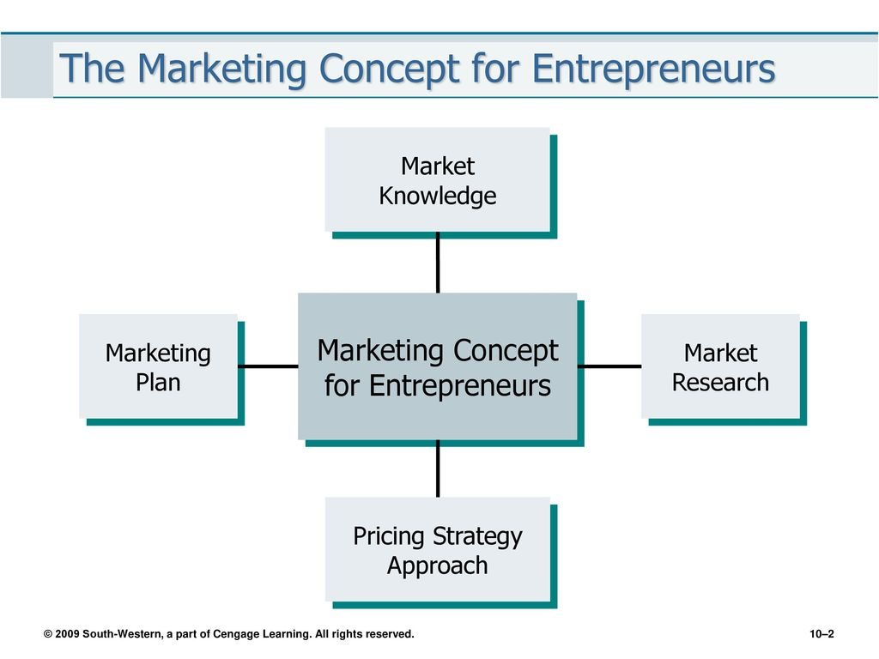
Chapter 10 The Marketing Aspect of New Ventures

Slide 2
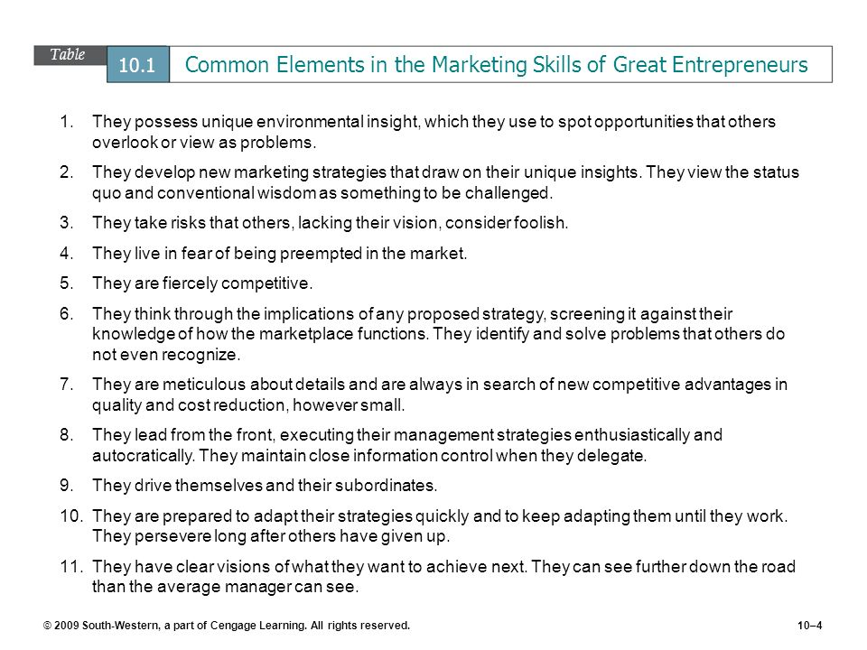

Slide 3
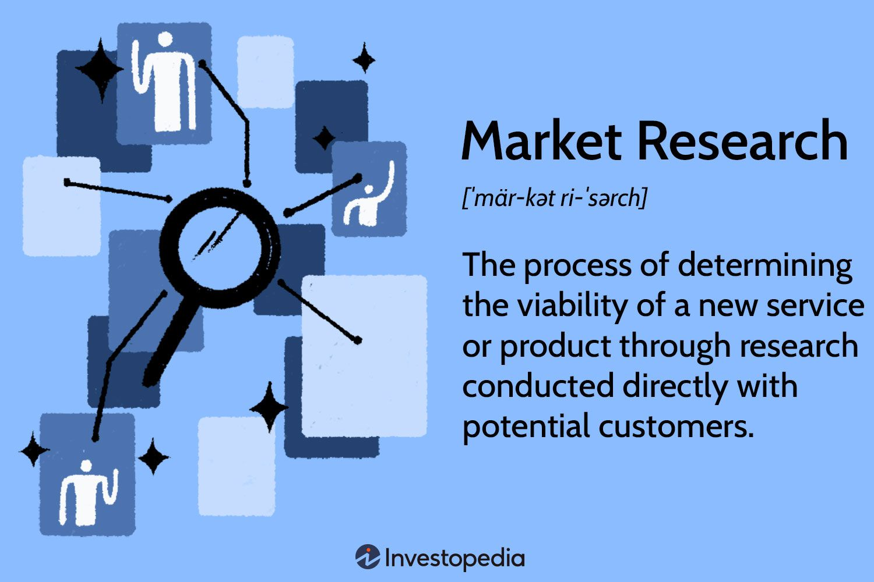

Slide 4
Research Purpose & Objectives
Following questions are suggested to establish objectives for general marketing research:
Where do potential customers go to purchase the good or services in question?
Why do they choose to go there?
What is the size of the market? How much it can the business capture?
How does the business compare with competitors?
What impact does the business’s promotion have on customers?
What type of products or services are desired by potential customers?

Slide 5
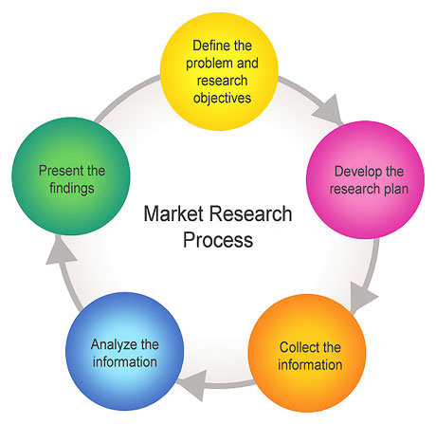

Slide 6
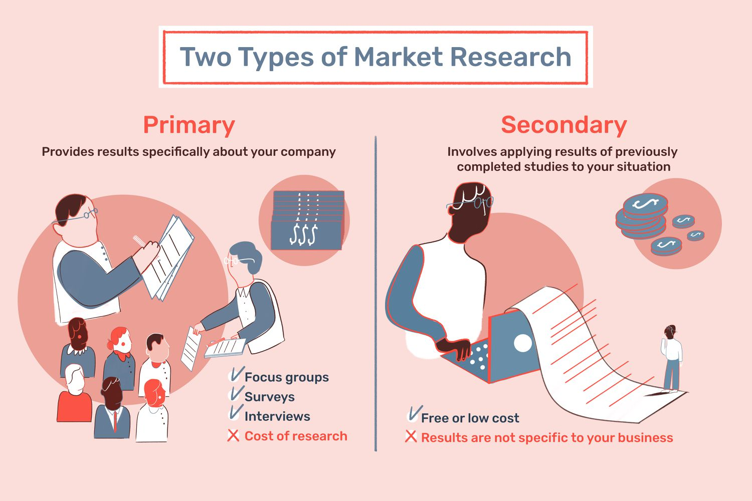

Slide 7
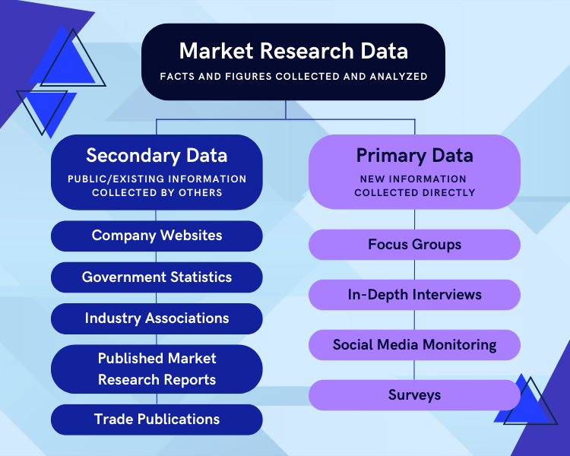

Slide 8


Slide 9
Few Marketing Research Questions
Sales
Do you know all you need to know about your competitors’ sales performance by type of product and territory?
Do you know which accounts are profitable and how to recognize a potentially profitable one?
Is your sales power deployed where it can do the most good and maximize your investment is selling costs?
Distribution
If you are considering introducing a new product or line of products, do you know all you should about distributors’ and dealers’ attitudes toward it?
Are your distributors’ and dealers’ salespeople saying the right things about your products and services?
Has your distribution pattern changed along with the geographic shifts of your markets?
Markets
Do you know all that would be useful about the differences in buying habits and tastes by territory and kind of products?
Do you have as much information as you need on brand or manufacturer loyalty and repeat purchasing in your product category?
Can you now plot, from period to period, your market share of sales by products?
Advertising
Is your advertising reaching the right people?
Do you know how effective your advertising is compared to that of your competitors?
Is your budget allocated appropriately for greater profit – according to products, territories, and market potentials?
Products
Do you have a reliable quantitative method for testing the market acceptability of new products and product changes?
Do you have a reliable method for testing the effect on sales of new or changed packaging?
Do you know whether adding higher or lower quality levels would make new profitable markets for your products?

Slide 10
Inhibitors to Marketing Research
Cost.
Complexity.
Strategic decisions.
Irrelevancy.

Slide 11
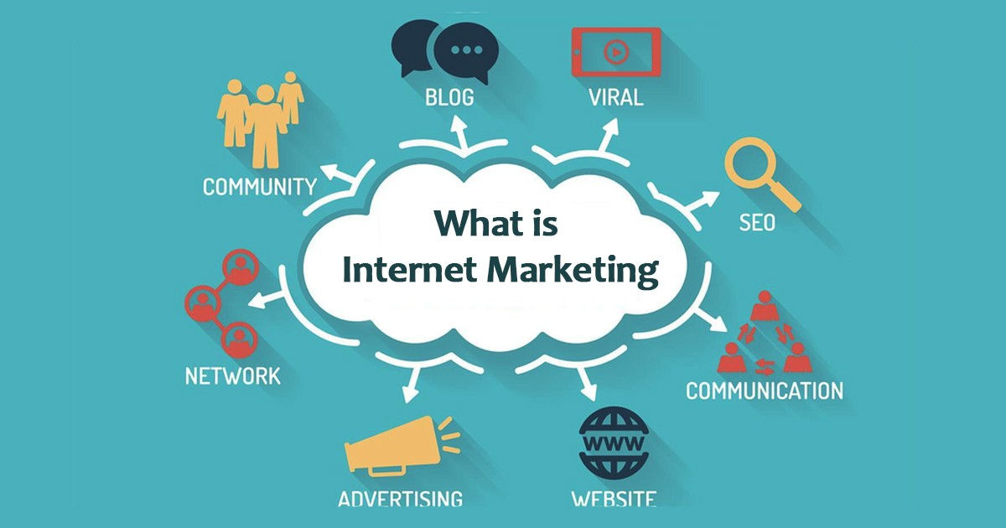

Slide 12
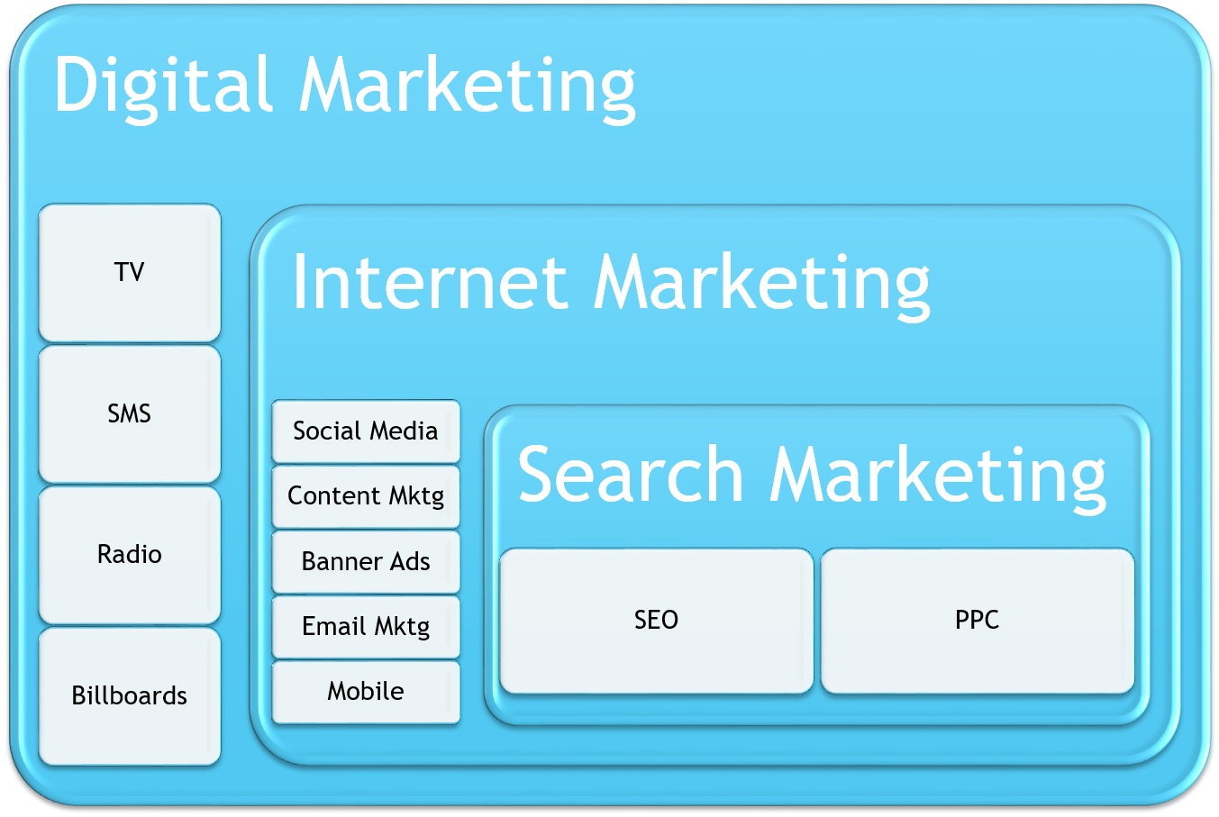

Slide 13
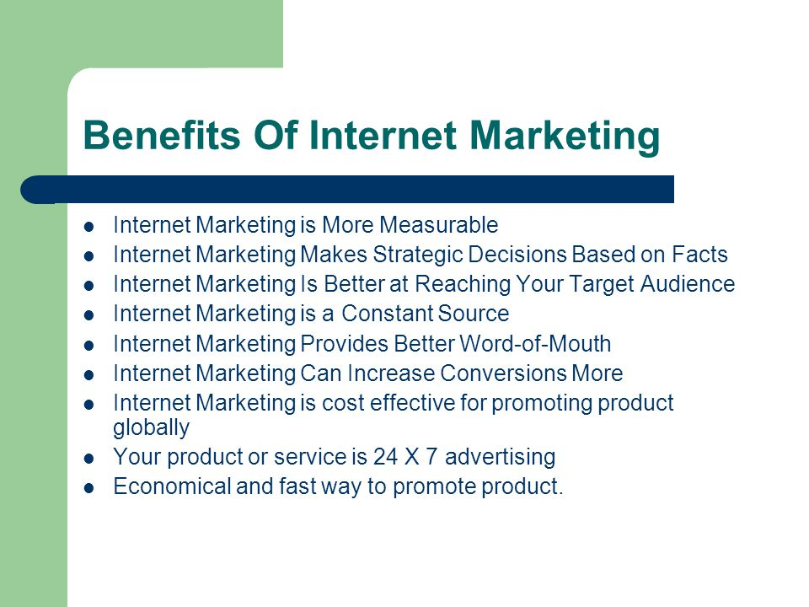

Slide 14
Effective Marketing Based on Three Key Elements
Marketing Philosophy.
Production driven philosophy.
Sales driven philosophy.
Consumer driven philosophy.
Market Segmentation.
Demographic variable (age, marital status, occupation, income, location)
Benefit variable (convenience, cost, style, trends)
Consumer Behavior.
Five types of consumers:
Innovators.
Early adopters.
Early majority.
Late majority.
Laggards.

Slide 15
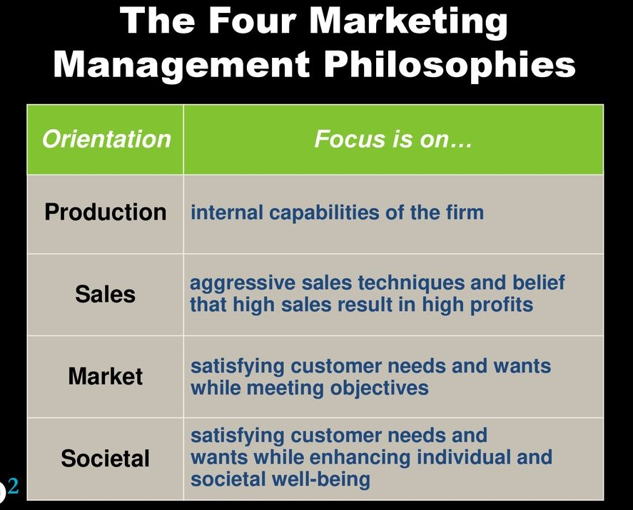

Slide 16
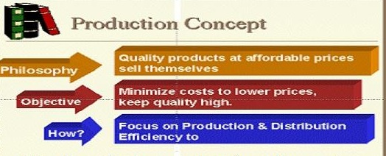

Slide 17
Three major factors influence the choice of a marketing philosophy
Competitive pressure.
Entrepreneur’s background.
Short-term focus.

Slide 18
Following is a list of techniques to use to assess your competition
Networking.
Related Products.
Value Chain.
Companies with Related Competencies.
Internet.

Slide 19
Entrepreneurs should be aware of five major consumer classifications
Convenience Goods –
Staple goods / impulse goods / emergency goods
Consumers will want these goods and services but will not be willing to spend time shopping for them.
Shopping Goods –
Products consumers will take time to examine carefully and compare for quality and price.
Specialty Goods –
Consist of products or services consumers make a special effort to find and purchase.
Unsought Goods –
Items consumers do not currently need or seek. Common examples are life insurance, encyclopedias, and cemetery plots. These products require explanation or demonstration.
New Products –
Items that are unknown due to lack of advertising or are new products that take time to be understood. When microcomputers were first introduced, for example, they fell into this category.

Slide 20
Developing a Marketing Plan
Following elements are critical for developing a marketing plan:
Current Marketing Research.
Who the customers? What they want? How they buy?
Current Sales Analysis.
Promoting and distributing products according to the research findings.
Marketing Information System.
Collecting, screening, analyzing, storing, retrieving, and disseminating marketing information on which to base plans, decisions, and actions.
Sales Forecasting.
Coordinating personal judgment with reliable market information.
Evaluation
Identifying and assessing deviations from marketing plans.

Slide 21
Current Market Research
The company’s major strengths and weaknesses.
Market profile.
Current and best customers.
Potential customers.
Competition.
Outside factors.
Legal changes.

Slide 22
Market Research is Expensive (Valuable tips to do market research)
Establish a contest that requires entrants to answer a few simple questions about the quality of your product.
Every organization receives the occasional complaint from a disgruntled customer.
Develop a standard set of questions regarding the quality of products / services and ask the same through telephone.

Slide 23
Current Sales Analysis (list of potential questions to be answered)
Do salespeople call on their most qualified prospects on a proper priority.
Does the sales force contact decision makers?
Are territories aligned according to sales potential and salespeople’s abilities?
Are sales calls coordinated with other selling efforts, such as trade publication advertising, trade shows and direct mails?
Do salespeople ask the right questions on sales calls?
Do sales reports contain appropriate information?
Does the sales force understand potential customers’ needs?
How does the growth or decline of a customers’ or a prospect’s business affect the company’s own sales?

Slide 24
Marketing Information System
A marketing information system must compile and organize relating:
To cost.
To revenue.
And profit.
Factors that affect the value of Marketing Information System:
Data reliability.
Data usefulness or understandability.
Reporting system timelines.
Data relevancy.
System error.

Slide 25

Sales Forecasting

Slide 26
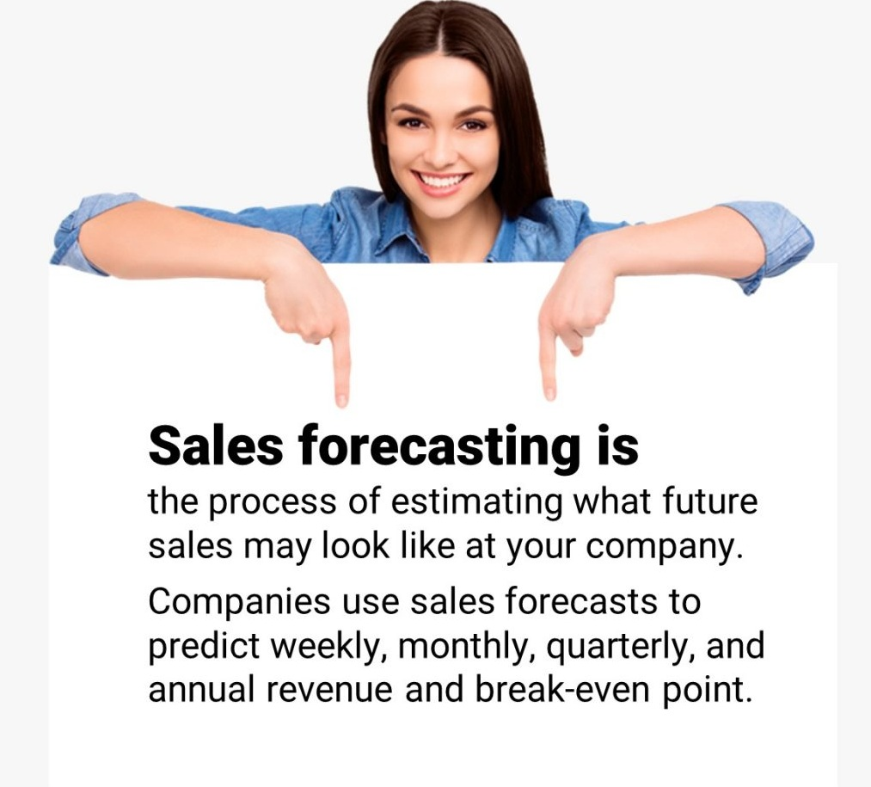

Slide 27
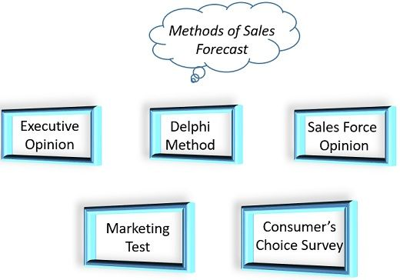

Slide 28
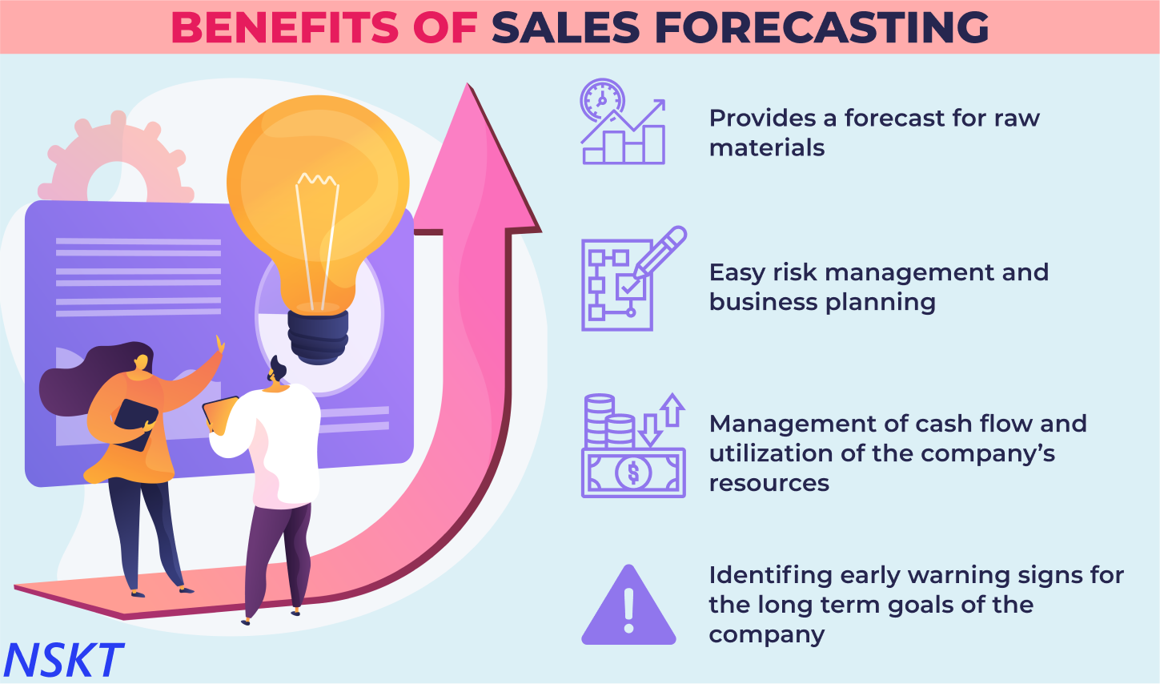

Slide 29
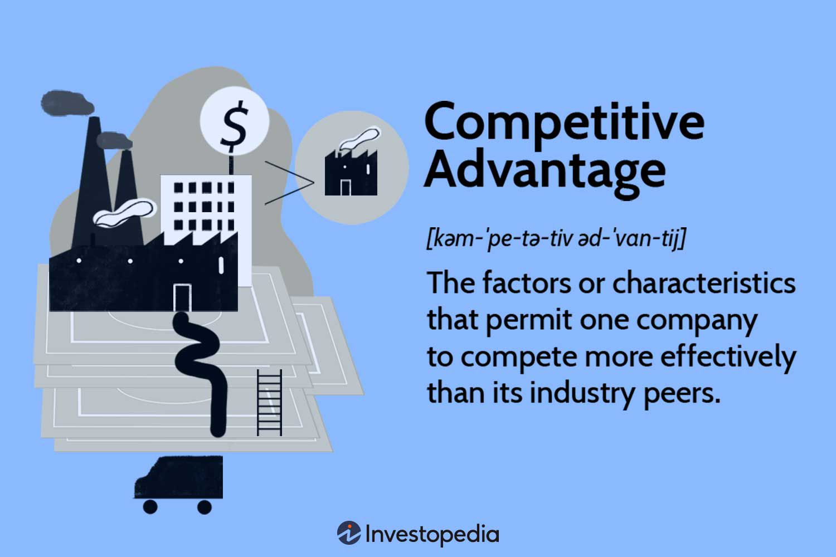

Slide 30
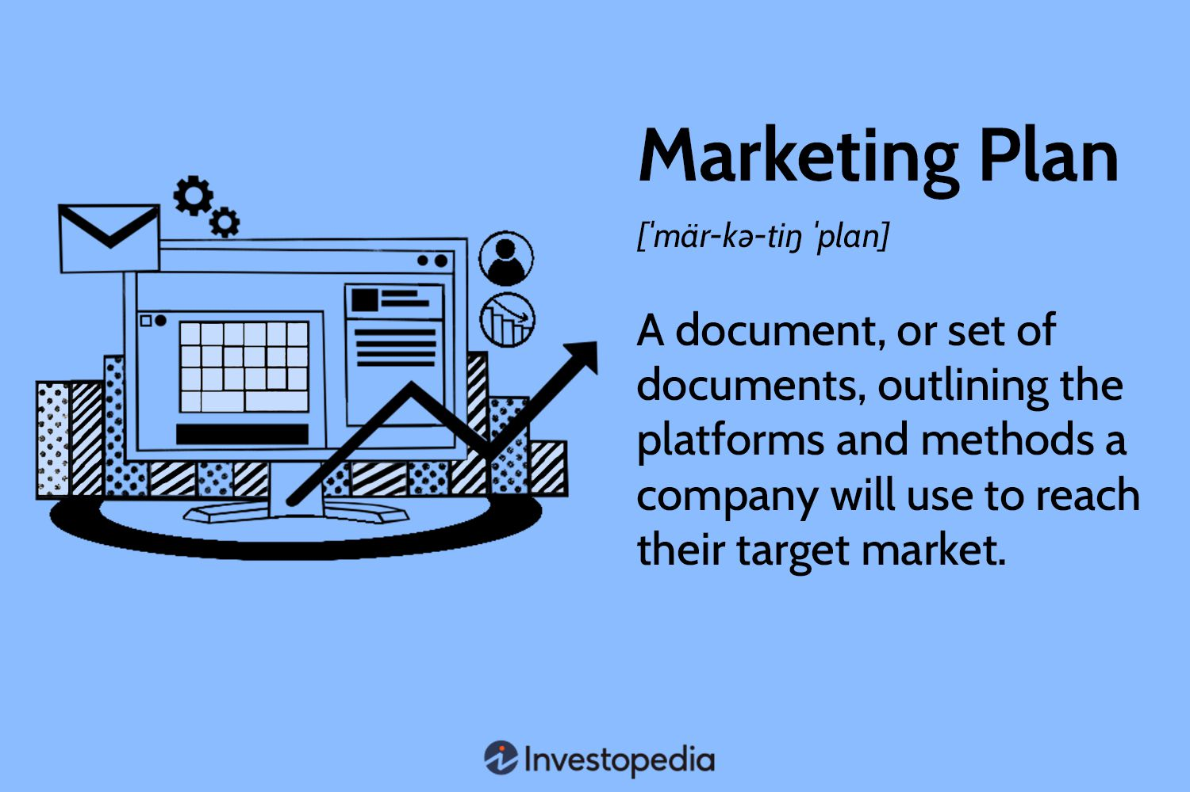

Slide 31
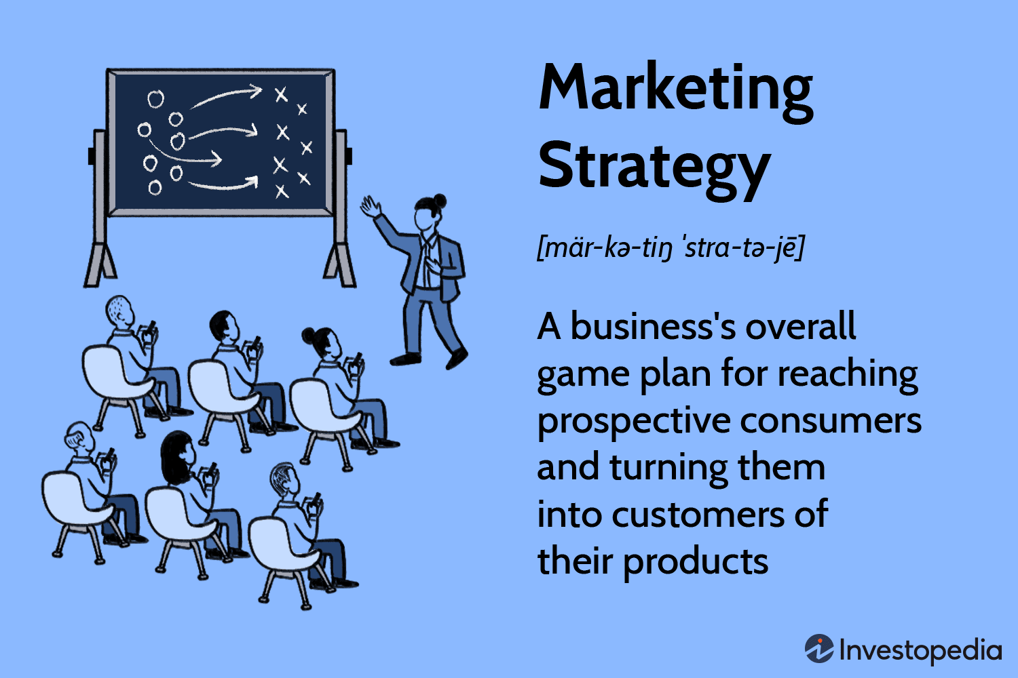

Slide 32
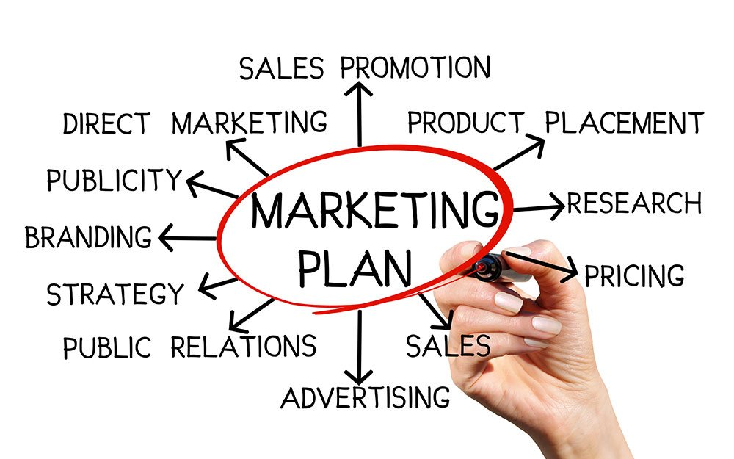

Slide 33
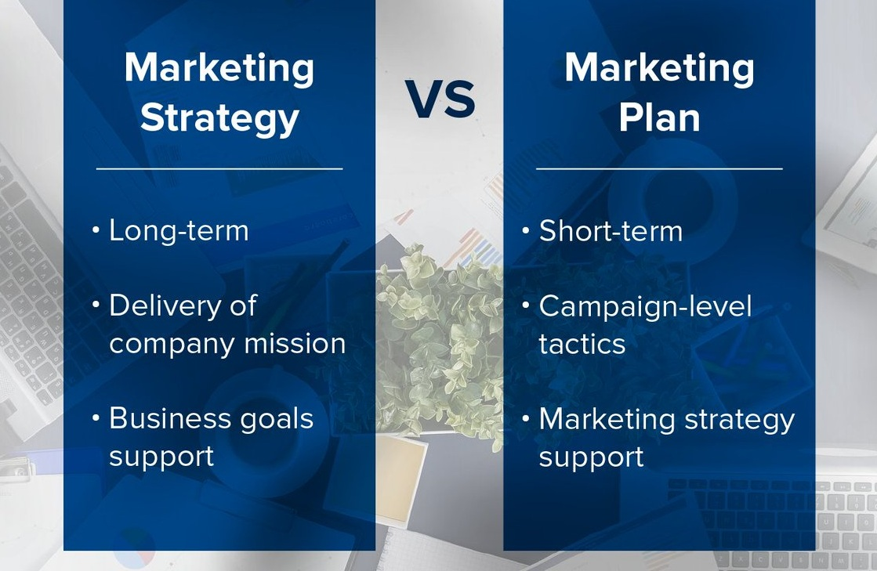

Slide 34
Final Considerations for Entrepreneurs (Formation of Marketing Plan)
Step 1: Appraise marketing strengths and weaknesses, emphasizing factors that will contribute to firm’s competitive advantage.
Product design / reliability / durability / price / quality / production capacities.
Step 2:Developing marketing objectives (short / medium / long sales goals).
These goals should be clearly stated, measurable and with companies capabilities.
Step 3:Develop product / service strategies
Identify the end users / wholesalers and retailers’ need.
Product design / features / performance / cost and price should be matched to these needs
Step 4: Strategies to achieve company’s immediate and long range sales goals and long rant marketing goals.
Step 5:Determine a pricing structure.

Slide 35
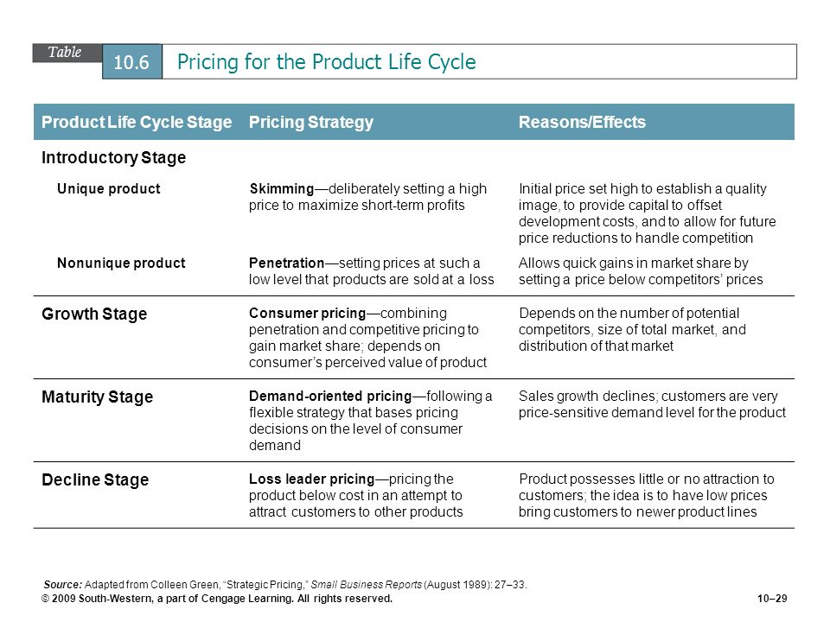

Slide 36
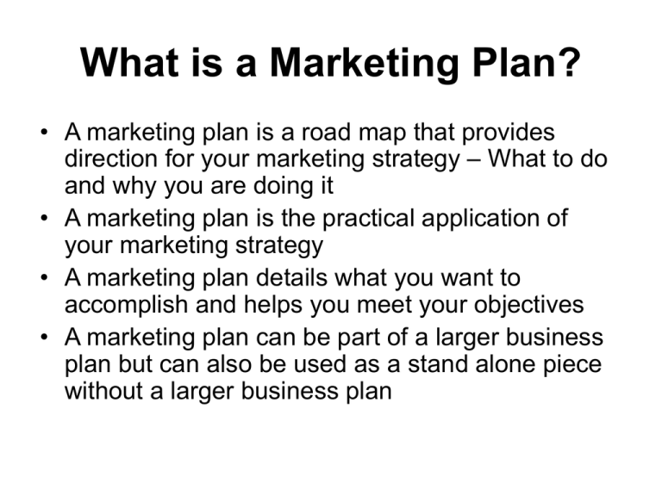

Slide 37
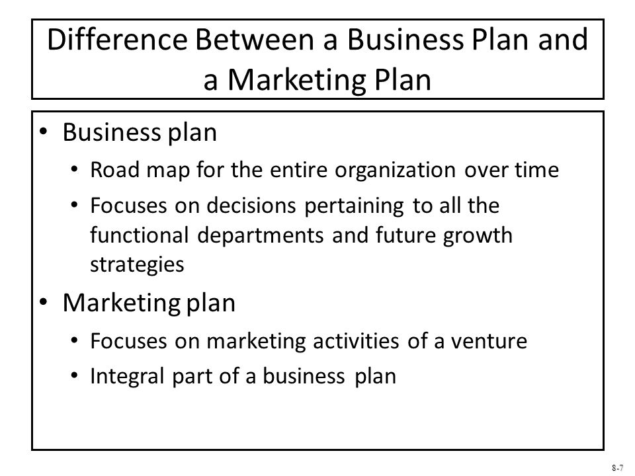

Slide 38
Outline of the Business Plan First “Cover Page” then “Table of Contents”
Executive Summary (if executive summary is convincing only then ask for full business plan)
Short overview of the entire business plan
Company Description
Company history
Mission statement
Products and services
Current status
Legal status and ownership
Key key partnerships (if any)
Industry Analysis
Industry size, growth rate, and sales projections
Industry structure
Nature of participants
Key success factors
Industry trends
Long term prospects
Market Analysis
Market segmentation and target market selection
Buyer behavior
Competitor analysis
Marketing Plan
Overall marketing strategy
Product, price, promotions, and distribution
Management Team and Company Structure
Management team
Board of Directors
Board of Advisers
Company Structure
Operations Plan
General approach to operations
Business location
Facilities and equipment
Product (or Service) Design and Development Plan
Development status and tasks
Challenges and risks
Intellectual property
Financial Projections
Sources and uses of funds statements
Assumptions sheet
Pro Forma Income statements
Pro Forma Balance Sheets
Pro Forma Cash Flows
Ratio Analysis

Slide 39
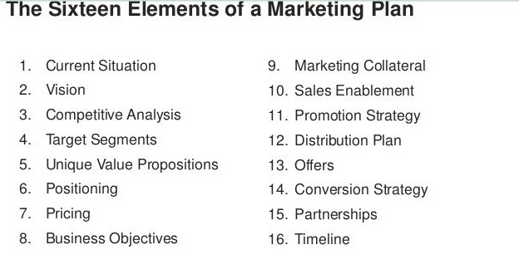

Slide 40


